Slide 1
Performance Reports
South Dakota One Call Board Meeting
June 27th, 2023
Keidre Adams
Operations Manager

Slide 2
4a. Incoming Ticket Volume

Slide 3
4a. Incoming Ticket Volume
Top Counties in Q2
Minnehaha 11,533
Lincoln 6,837
Pennington 4,815
Brookings 2,765
MINNEHAHA

Slide 4
4b. Ratio (Outgoing to Incoming)

Slide 5
4c. Electronic Ticketing

Slide 6
4c. Electronic Ticketing (Homeowner)

Slide 7
4d. Secondary Links (Additional Outputs)

Slide 8
4e. Ticket Types

Slide 9
4e. Ticket Types

Slide 10
4f. Speed of Answer

Slide 11
4g. Damages with Previous Tickets
0.80% of volume for the quarter.
There were 100 occurrences in Q1 compared to 480 in Q2.
Notes:
There was a reduction in the number of occurrences in April and MTD so far. There was increase in May, but it may be contributed to the peak season ramping up.

Slide 12
4h. Damages without Previous Tickets
Notes:
This is what we like to see. There was a reduction for all months in Q2 compared to Q2 last year.
0.15% of total volume

Slide 13
4i. Gas Damages

Slide 14
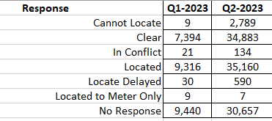
4j. Positive Response
Total of 104,220 responses entered in Q2.
Q1 vs Q2

